Slide 1
ROUND TABLE WITH PACIFIC WOMEN: ADDRESSING SIDS ISSUES FROM LOCAL TO GLOBAL FOOD SECURITY IN RELATION TO TOXIC SUBSTANCES
Imogen Ingram, Te Pa Mataiapo
ISLAND SUSTAINABILITY ALLIANCE CIS INC. (“ISACI”)
Cook Islands

Slide 2
OVER-USE OF PESTICIDES IN AGRICULTURE
1.Pesticides include:
herbicides i.e. to kill weeds
insecticides i.e. to kill pests
fungicides i.e. to to kill fungal growths
2.over-use of pesticides is a food security issue for land-based food sources (residues)
3.for subsistence fishing (because of run-off)
4. Many pesticides are considered by scientists to be endocrine-disrupting chemicals, as they interfere with the body’s hormones.

Slide 3
POOR WASTE DISPOSAL PRACTICES
Inappropriate disposal of waste e.g. into landfills, swamps or lagoons usually results in leachate i.e. ooze containing toxic substances like lead, cadmium, mercury, PBDEs from plastics containing brominated flame retardants
Many items become hazardous waste when they break down or are discarded
E-waste is one of the fastest growing hazardous wastes in developing countries (often landfilled without any thought to consequences)

Slide 4
EMERGING ISSUE Toxic Substances in Food
Negotiation of the new Minamata Convention on mercury was completed in January 2013
Diplomatic convention for signing will be in Japan in October 2013
To highlight food contamination, IPEN and Biodiversity Research Institute took global hair samples
Only Japan and Cook Islands took part from the Pacific
These were among the highest readings for methylmercury in fish
For Cook Islands the source is assumed to be from global mercury pollution

Slide 5
EMERGING ISSUE DEEP-SEA MINERAL MINING
No analysis of risks of deepsea mining – only benefits are promoted by governments and companies
EIAs are supposed to be carried out to assess the impact of potential contamination of seafoods by effluent from mining seabed minerals
Currently China has the monopoly on production of rare earths, used in electronics
Recent research shows that these are present in mud on the seafloor in Cook Islands
Responsible U.S. extracting company says you need a whole laboratory in order to safely mine rare earths on land. Underwater, it would be impossible to contain contamination.

Slide 6
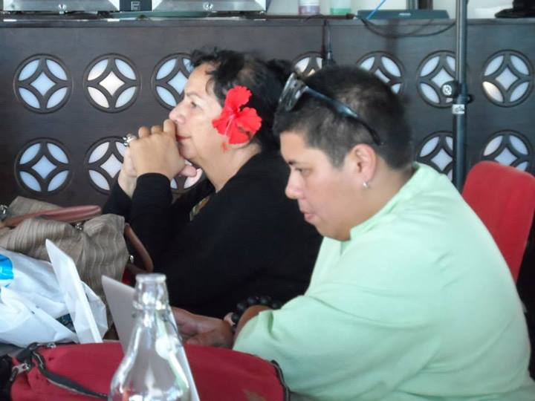
Womens MG Team working on MG & Partners Statement

Slide 7
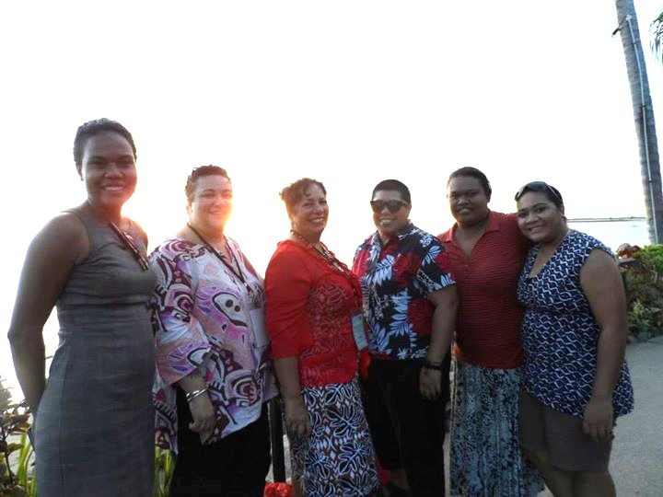
PSIDS - Womens Major Group Advocacy Team

